Slide 1

ME 964: Project -1 Finite Element Formulation for Plates Shiguang Deng Xingchen Liu Goldy Kumar

Slide 2
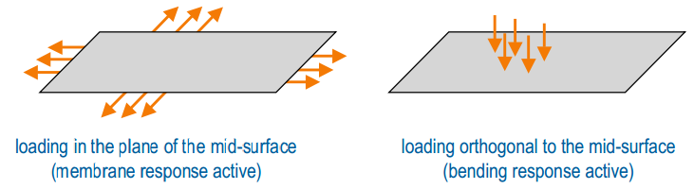
FEM for Plates
A plate is a flat three dimensional solid body with
one dimension is much smaller than the other two
zero curvature at mid-surface in the reference configuration
loading that causes bending deformation
membrane and bending response are decoupled
investigated independently and later superposed
Notes:
Do not solve by 3D mesh because: coarse mesh leads to shear locking and ill conditioning, fine mesh end up with too many dof.

Slide 3
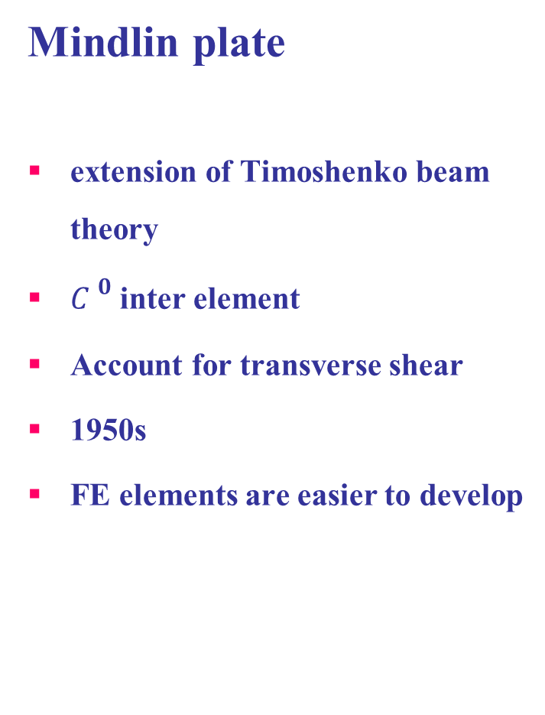
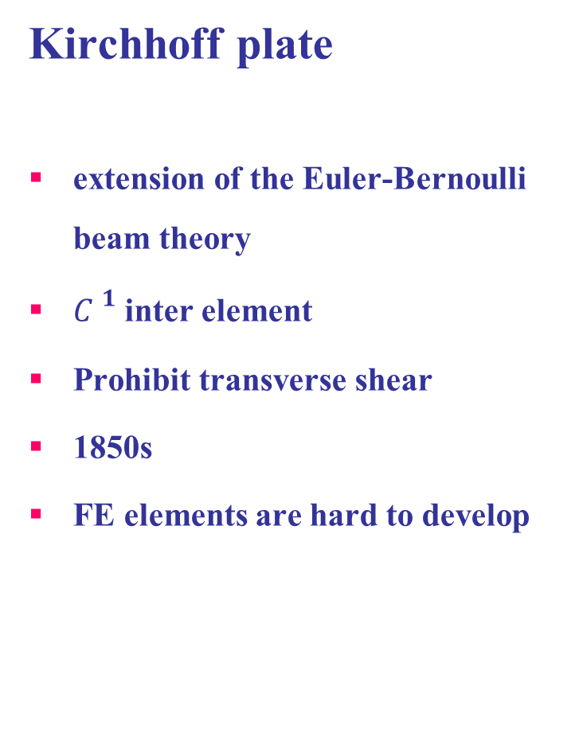
Plate Theories
Kirchhoff plate
extension of the Euler-Bernoulli beam theory
${C }^{1}$ inter element
Prohibit transverse shear
1850s
FE elements are hard to develop
Mindlin plate
extension of Timoshenko beam theory
${C }^{0}$ inter element
Account for transverse shear
1950s
FE elements are easier to develop

Slide 4
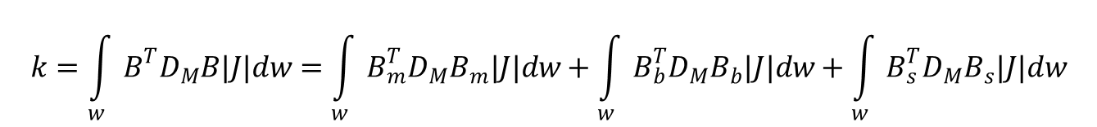
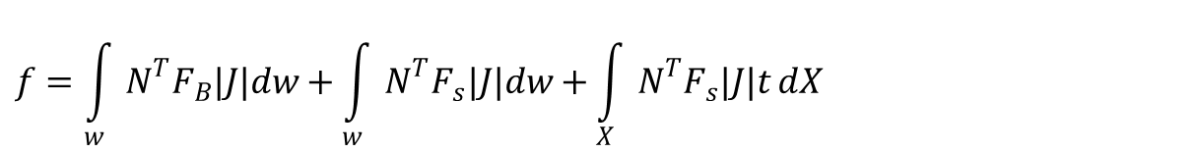
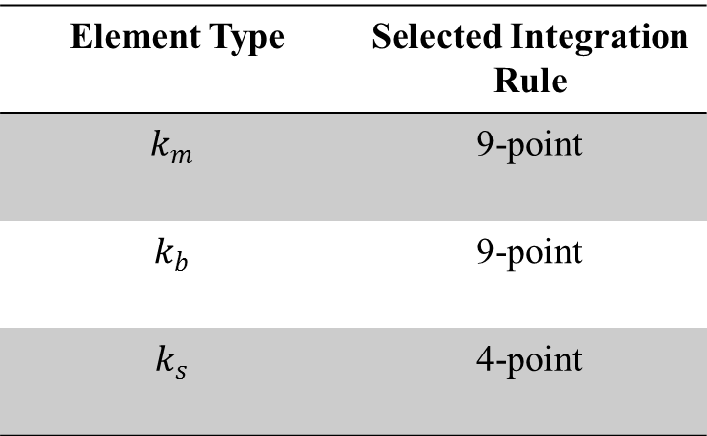
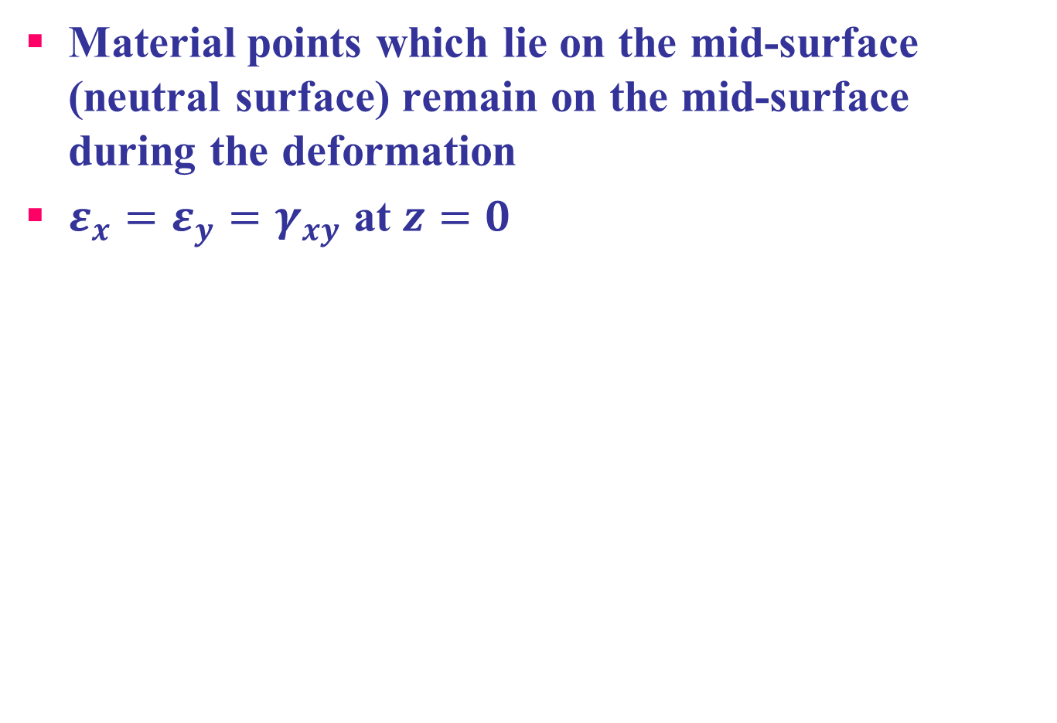
Isoparametric Mindlin Plate FE
Element Stiffness Matrix
$$k=\int_{w}{B^{T}D_{M}B|J|dw}=\int_{w}{B_{m}^{T}D_{M}B_{m}|J|dw}+\int_{w}{B_{b}^{T}D_{M}B_{b}|J|dw}+\int_{w}{B_{s}^{T}D_{M}B_{s}|J|dw}$$
$$\begin{matrix}k_{m}=\int_{w}{B_{m}^{T}D_{M}B_{m}|J|dw} \\ k_{b}=\int_{w}{B_{b}^{T}D_{M}B_{b}|J|dw} \\ k_{s}=\int_{w}{B_{s}^{T}D_{M}B_{s}|J|dw}\end{matrix}$$
Element Type | Selected Integration Rule
$$k_{m}$$ | 9-point
$$k_{b}$$ | 9-point
$$k_{s}$$ | 4-point
Nodal Load Vector
$$f=\int_{w}{N^{T}F_{B}|J|dw}+\int_{w}{N^{T}F_{s}|J|dw}+\int_{X}{N^{T}F_{s}|J|t}dX$$

Slide 5
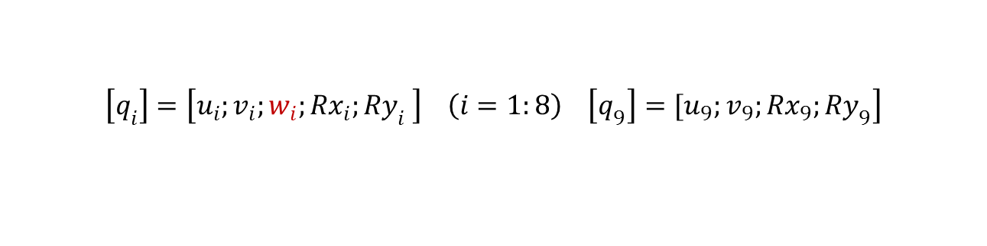
Heterosis Plate Elements & Gaussian Integration points
t
7
4
4
7
3
3
y
8
6
6
s
9
8
9
1
2
5
x
1
5
2
$$\left.\left[q_{i}\right]=\left[u_{i};v_{i};w_{i};Rx_{i};Ry_{i} \right] \left(i=1:8\right) \left[q_{9}\right]=[u_{9};v_{9};Rx_{9};Ry_{9}\right]$$
4-point
9-point

Slide 6
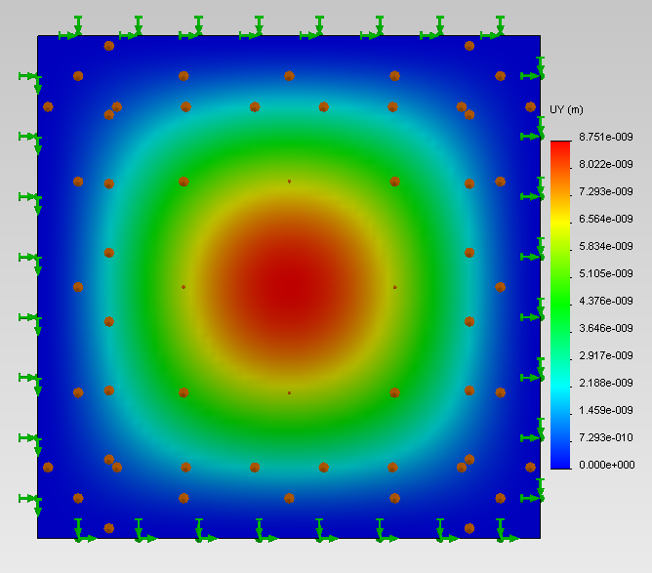
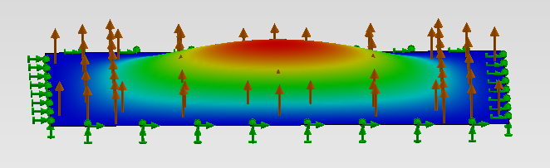
Results:
Plate Analyzed
- A rectangular plate 1x1x.02m³
- All four sides Clamped
- 1 Pa Pressure on the plate
Mid point displacement
From FEM code: 8.69e-9m
From SolidWorks: 8.751e-9m
From Analytical: 8.6e-9m

Slide 7
Numerical Results & Verification & Challenges
Plate Thickness | FEA(500elems) | Analytical | Errors
2e-2 | 8.687502e-009 | 8.599500e-009 | 1.012976%
1e-2 | 6.893745e-008 | 6.885245e-008 | 0.123287%
2e-3 | 8.629722e-006 | 8.599500e-006 | 0.350209%
1e-3 | 2.485991e-005 | 6.885245e-005 | 63.893921%
Mesh Density | FEA(t=1e-2) | Errors
20 | 2.889219e-008 | 58.037528%
100 | 6.690380e-008 | 2.830182%
500 | 6.893745e-008 | 0.123287%
1000 | 6.922092e-008 | 0.535158%
1500 | 6.914186e-008 | 0.420333%
Analytical | 6.885245e-008 | 0

Slide 8
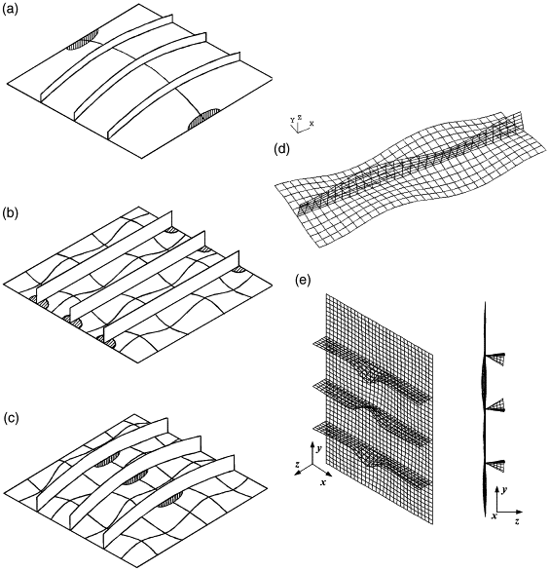
Next Step
Based on topology optimization, design of stiffener distributions and orientations for thin plate will be carried out to minimize compliance, stress and buckling stress.

Slide 9
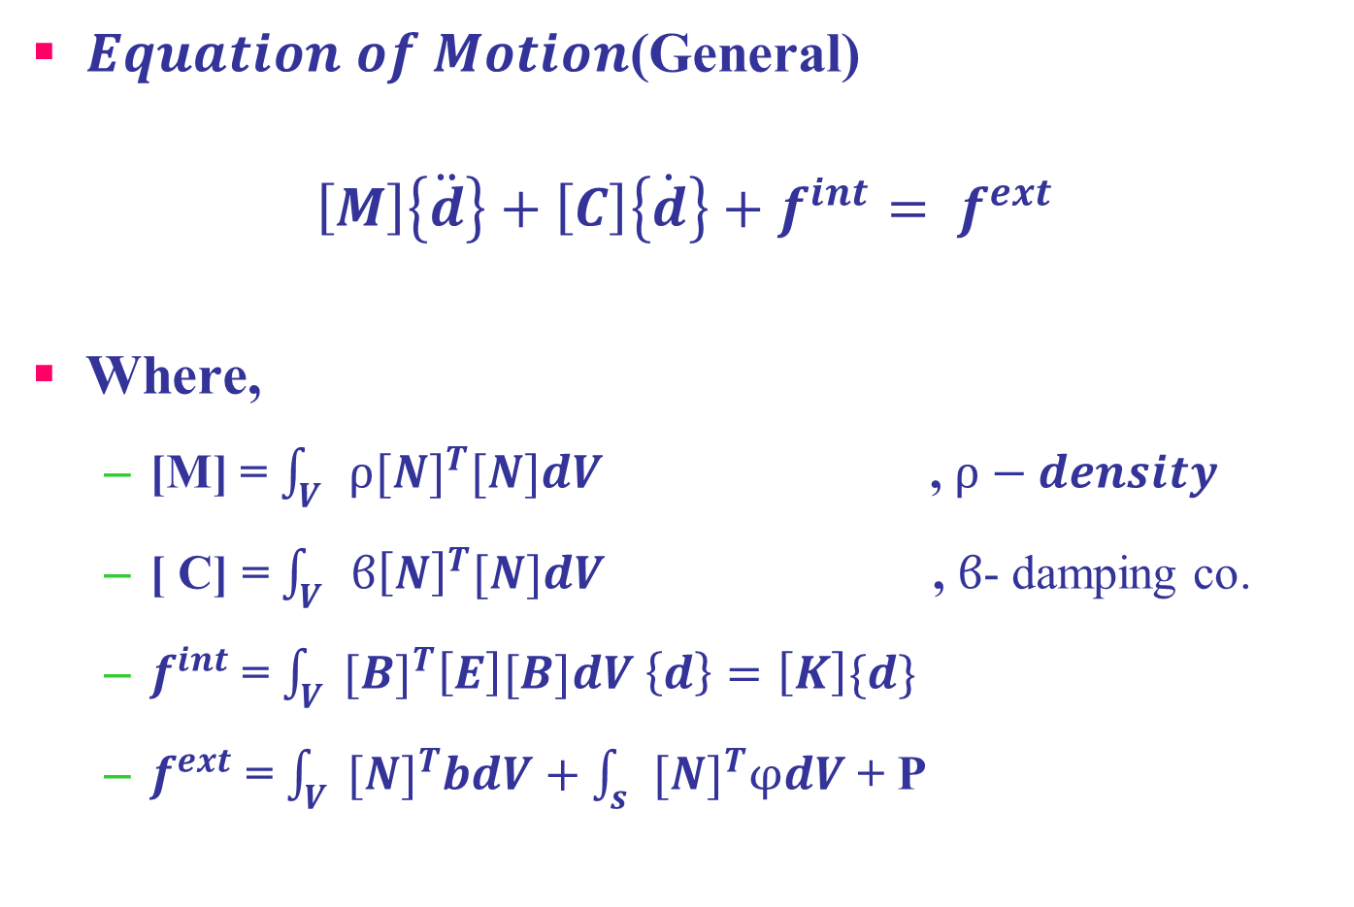
Next Project- Plate Eigen Value Problem
$Equation of Motion$(General)
$$\left[M\right]\left\{\ddot{d}\right\}+\left[C\right]\left\{\dot{d}\right\}+f^{int}= f^{ext}$$
Where,
[M] = $\int_{V}{ρ{[N]}^{T}[N]dV}$ , $ρ−density$
[ C] = $\int_{V}{ϐ{\left[N\right]}^{T}[N]dV}$ , $ϐ$- damping co.
$f^{int}$ = $\int_{V}{{[B]}^{T}\left[E\right][B]dV \left\{d\right\}=\left[K\right]\{d}\}$
$f^{ext}$ = $\int_{V}{{[N]}^{T}bdV}+\int_{s}{{[N]}^{T}φdV}$ + P

Slide 10
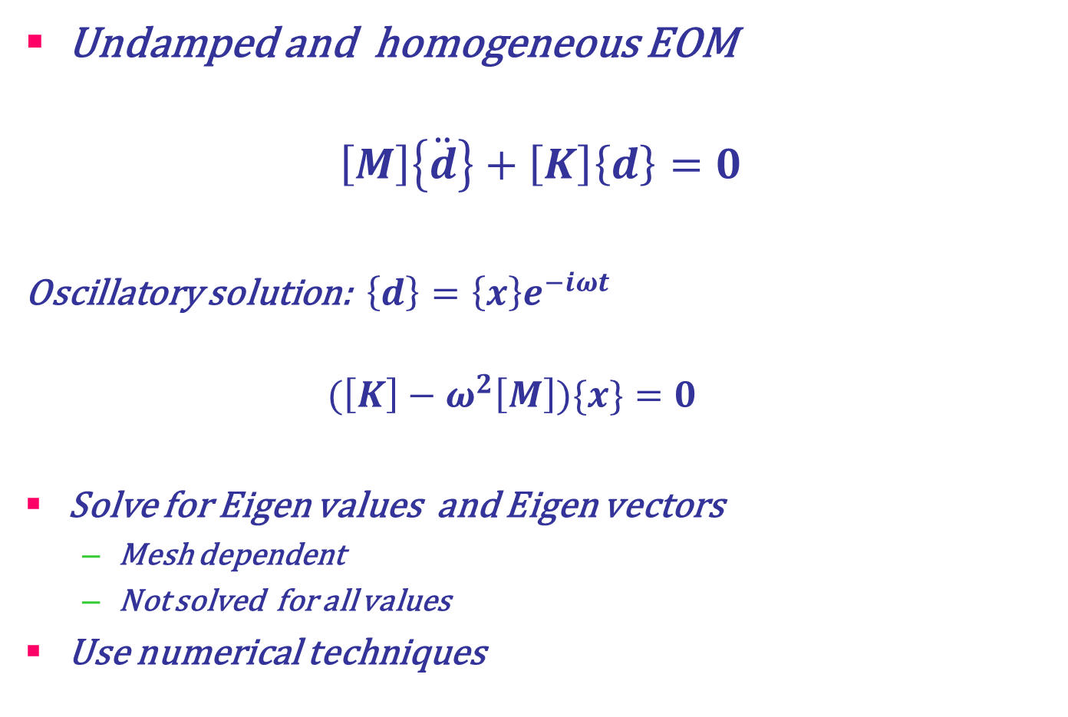
Natural Frequency and Mode Shapes
Undamped and homogeneous EOM
$$\left[M\right]\left\{\ddot{d}\right\}+\left[K\right]\left\{d\right\}=0$$
Oscillatory solution: $\left\{d\right\}=\left\{x\right\}e^{−iωt}$
$$(\left[K\right]−ω^{2}\left[M\right])\{x\}=0$$
Solve for Eigen values and Eigen vectors
Mesh dependent
Not solved for all values
Use numerical techniques
Vibration mode
A configuration with elastic resistance in balance with inertial loads

